Slide 1

Madison Parham
Summer 2018
#DoingThings
Corporate Internal
Communications Intern

Slide 2
What is communications?
Communications is the sharing or exchanging of information or news
What is internal communications?
Internal communications includes everything that gets created and communicated within an organization
What does this mean for Mr. Cooper?
Communications in this company are shared to more than 8,000 team members daily
The communications we send are transparent and help our team members stay up-to-date with what’s going on throughout the company

Slide 3
Day-to-Day

Slide 4

Internal Communications
  Connect – News, Announcements, Events
  Emails
  Huddle Points
  Yammer
  Newsstand (TVs)
  In Case You Missed It
  Hanging with Jay – Talking points

Slide 5
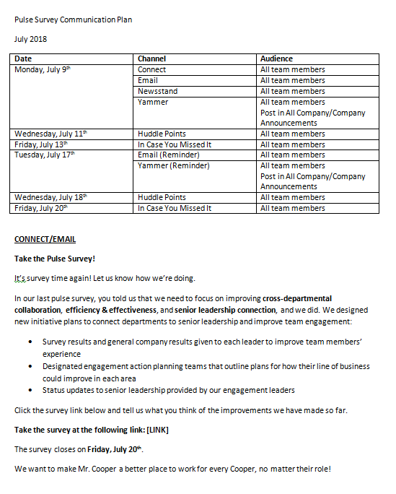
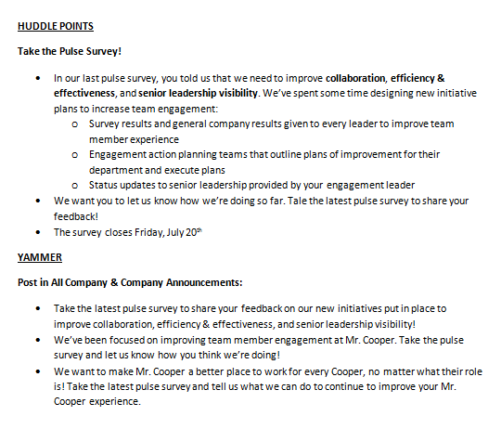
Communication Plans
Friends and Family Discount Marketing Tool Kit
Friends and Family Discount Giveaway
Kindness Cards
Summer Meals Events
Design Your Career
Pulse Survey
TouchCare Contest
Summer Full of Yammer
CPR & AED Training
Rally Communication

Slide 6
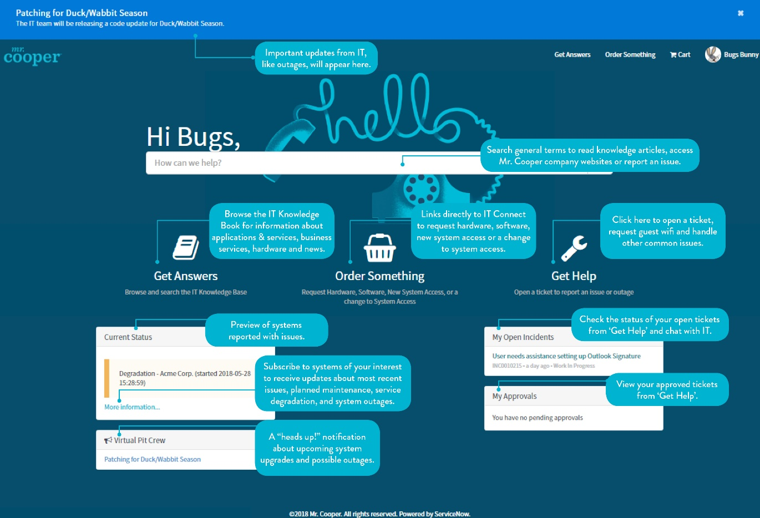
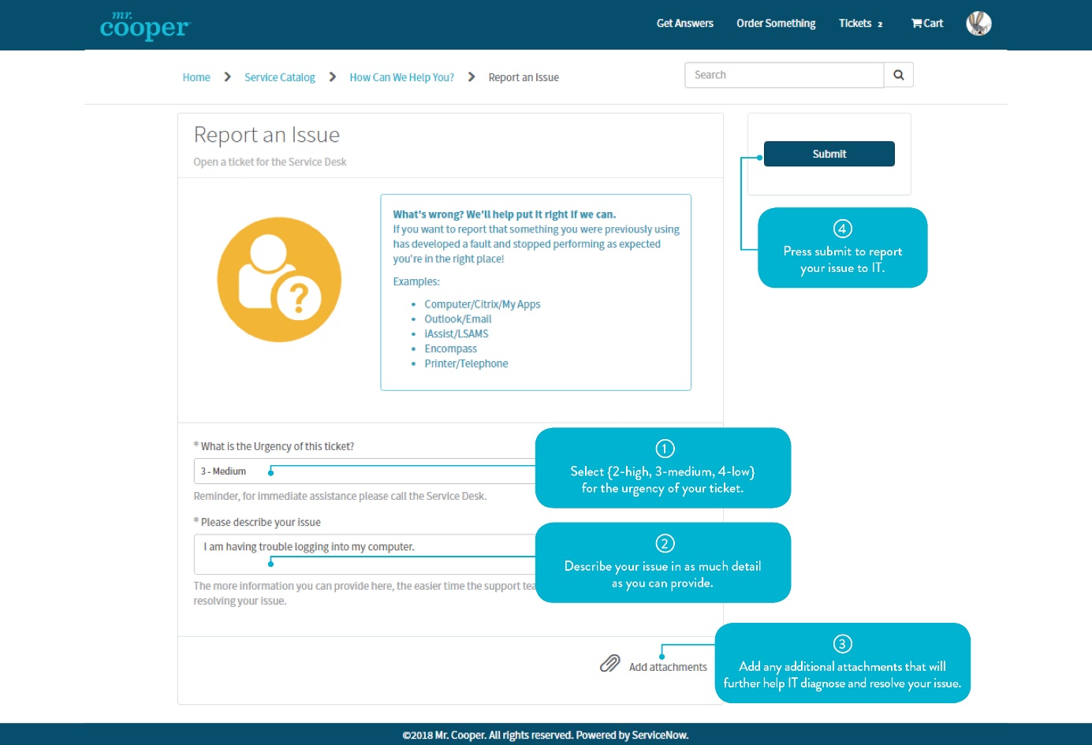
Service Now How-To’s

Slide 7


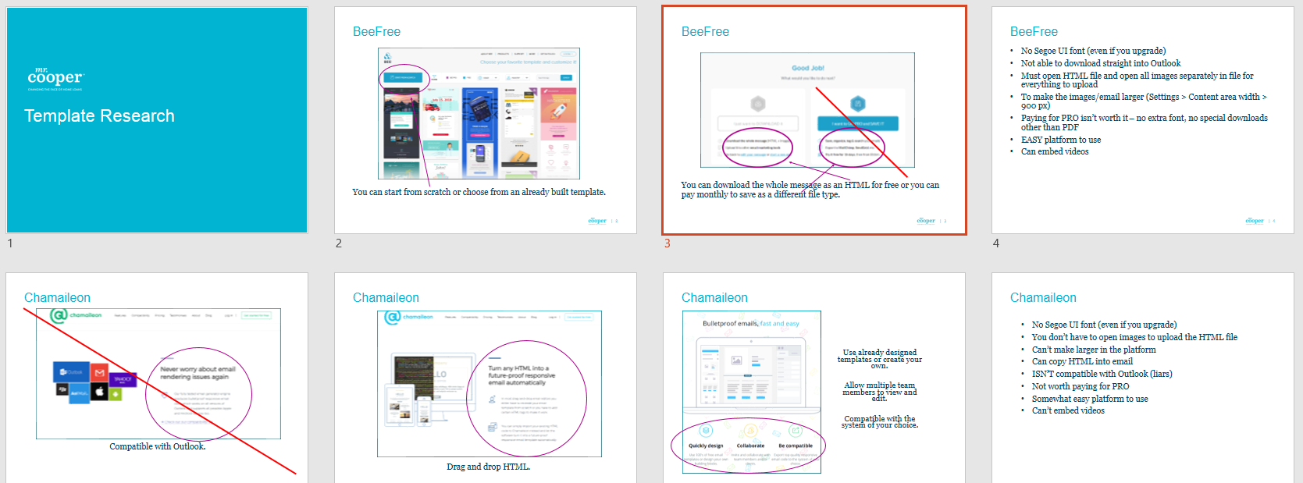
Research
  Responsible for researching Bank of America’s innovative AI system
  Responsible for researching competitor’s public responses to customer complaints regarding lawsuits, delinquencies, and foreclosures
  Responsible for researching email template platforms for the communications team to switch to from Microsoft Word

Slide 8
Summer Full of Yammer

Slide 9

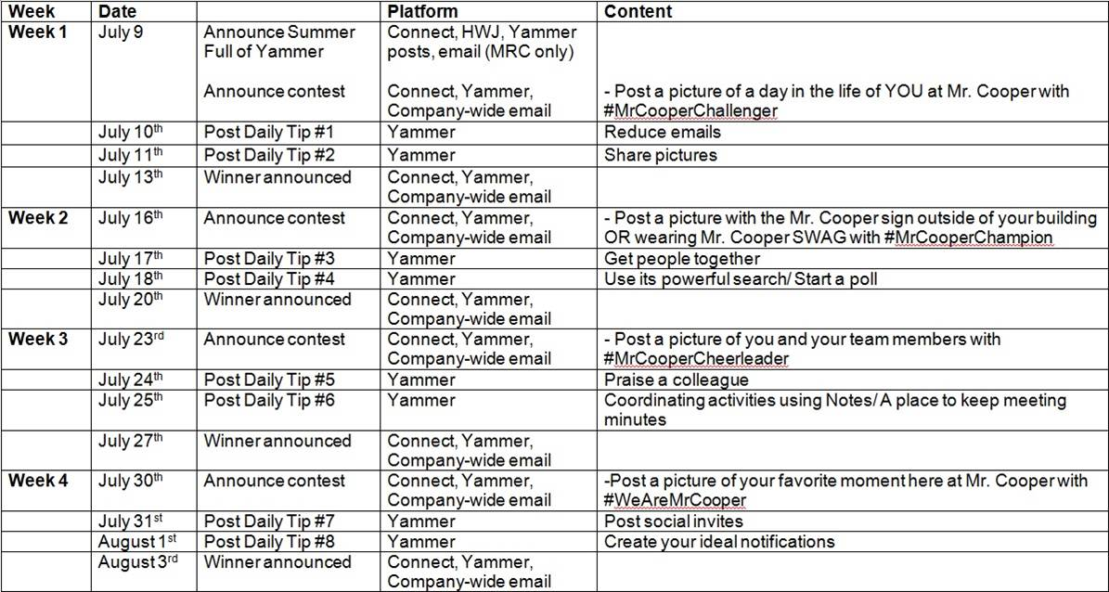
Campaign Overview
To increase Yammer engagement among team members
To promote Mr. Cooper’s three values: Challenger, Champion, and Cheerleader
1 contest per week; 4 contests total
    #MrCooperChallenger
    #MrCooperChampion
    #MrCooperCheerleader
    #WeAreMrCooper
3 winners per contest
2 #YamTips posted per contest

Slide 10
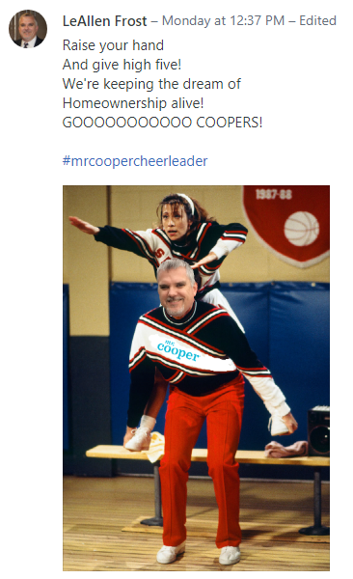
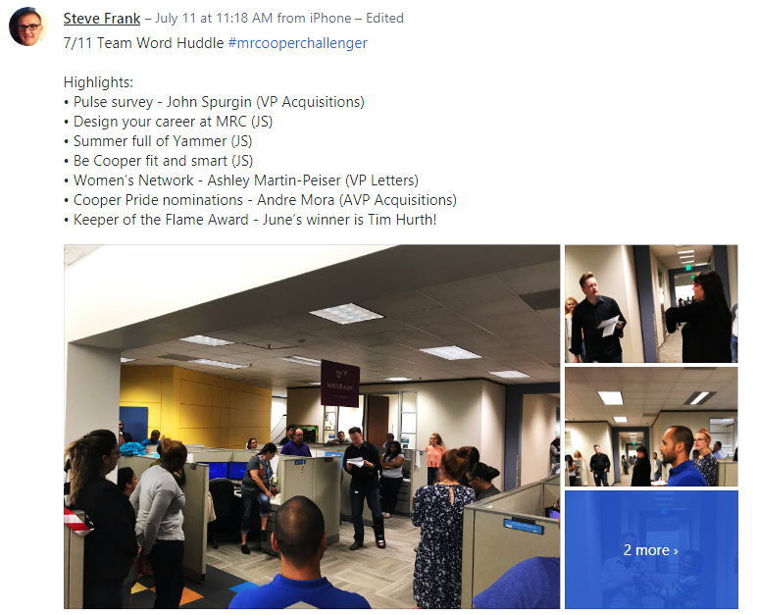
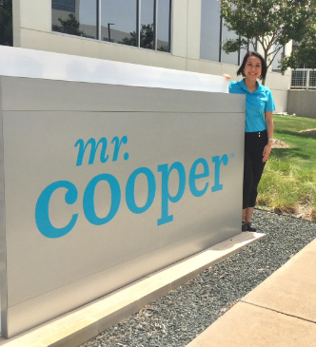
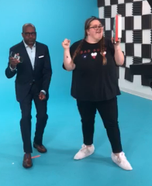
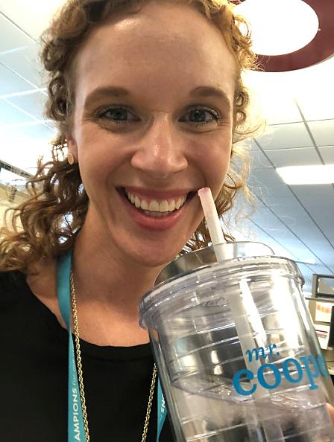
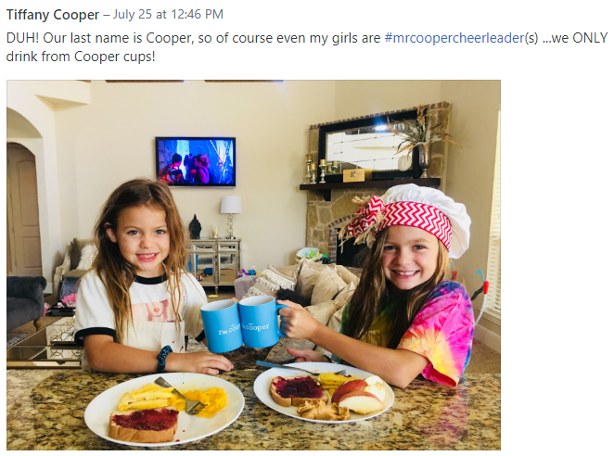
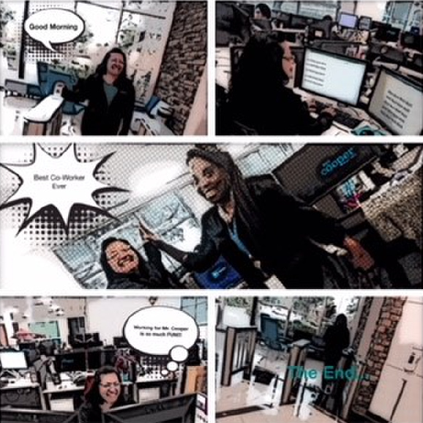
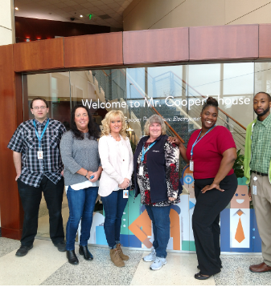

Slide 11
Connect-
Newsroom

Slide 12
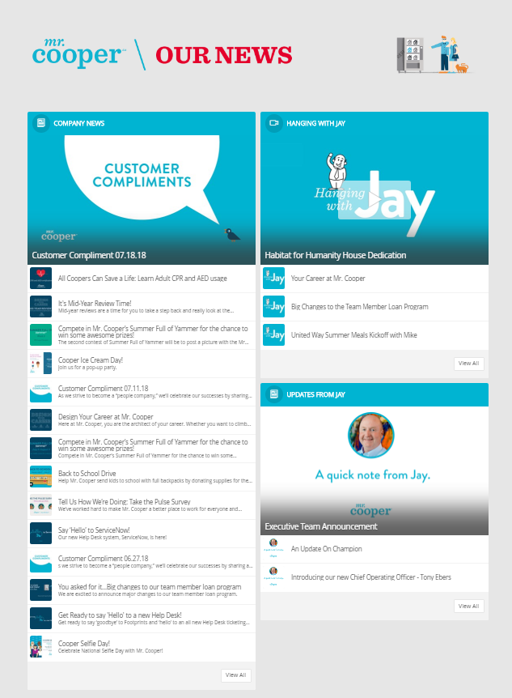
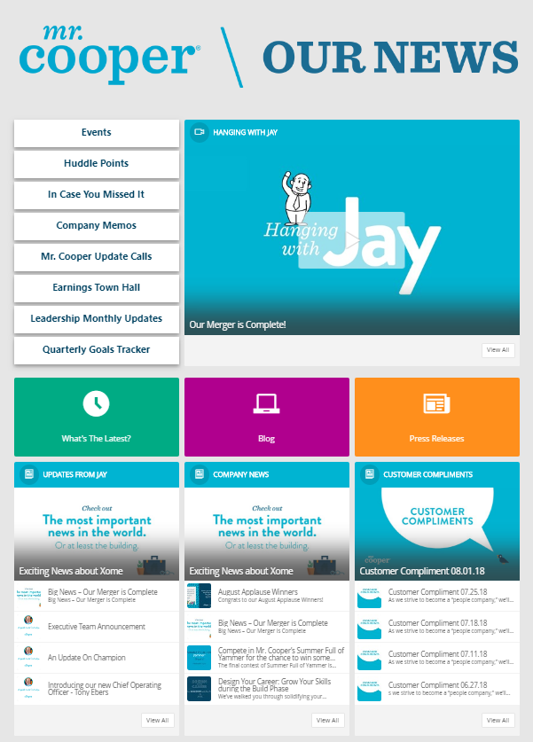
Newsroom
AFTER
BEFORE
Notes:
The new page is organized by the specific type of news rather than everything in one place. It allows easy access to Huddle Points, In Case You Missed It, Mr. Cooper Update Calls, and so much more that may have not been available to all team members before. There is also easy access to Mr. Cooper’s blog, press page, and the all new What’s The Latest page that is now available to all team members, not just the communications team.

Slide 13
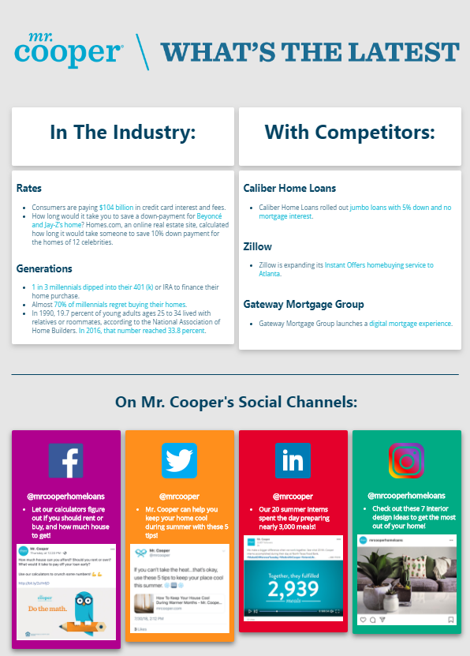
What’s
The
Latest?
BRAND NEW

Slide 14
Connect-
Marketing

Slide 15
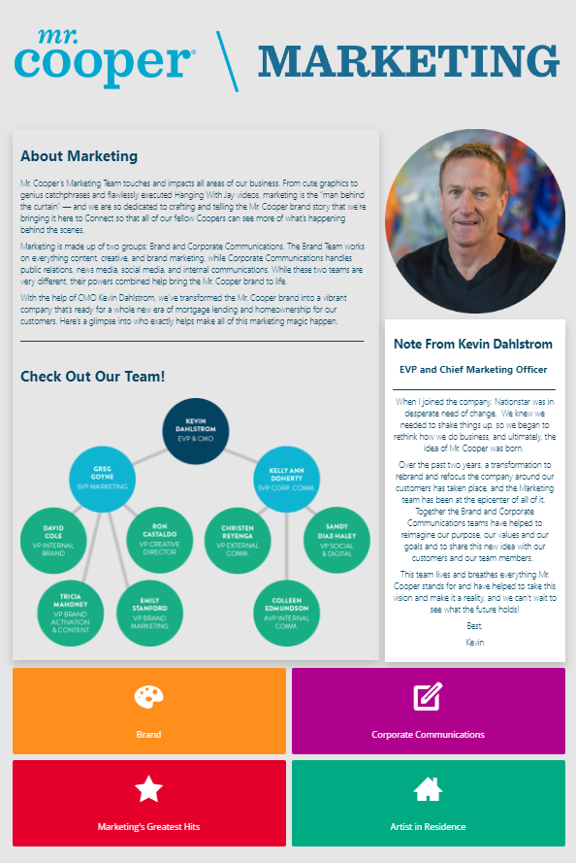
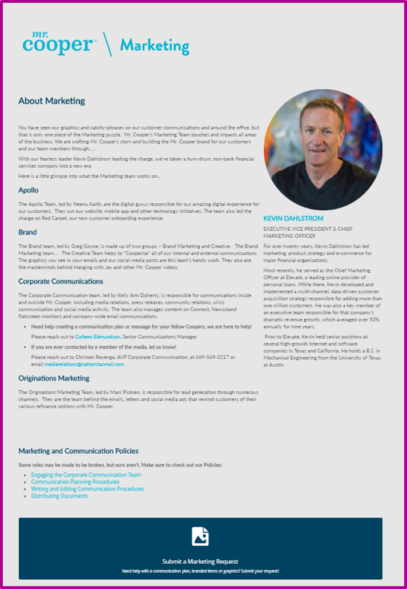
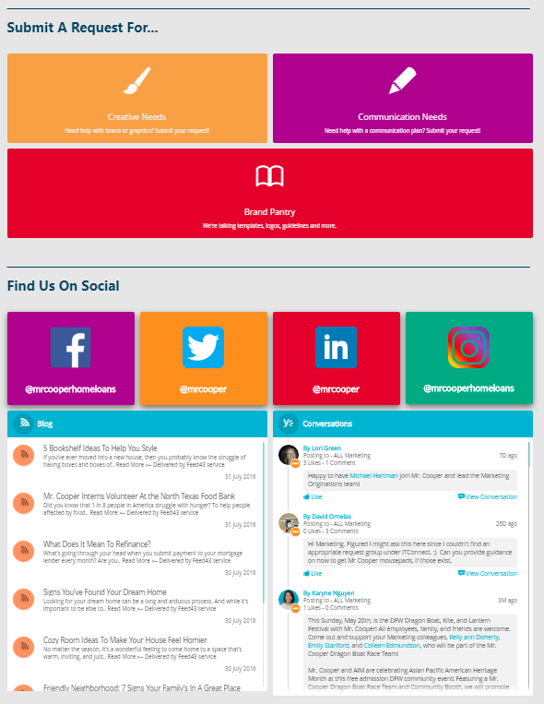
Marketing
BEFORE
AFTER

Slide 16
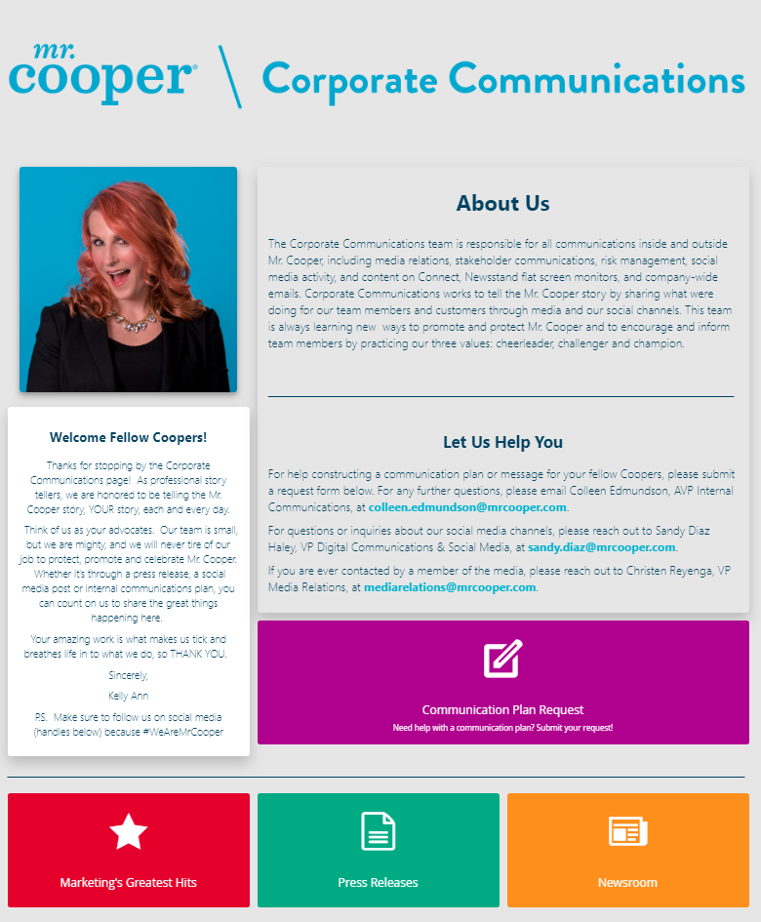
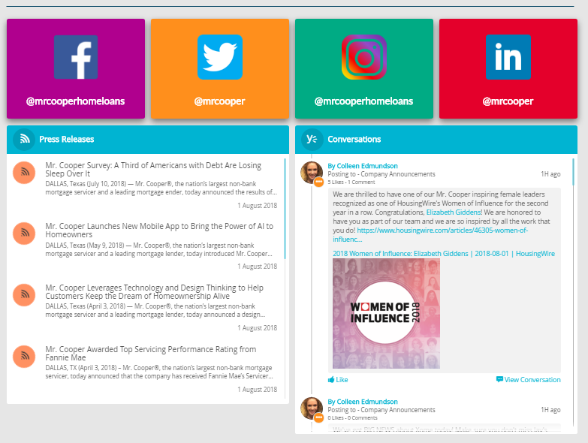
Corporate
Communications
BRAND NEW

Slide 17
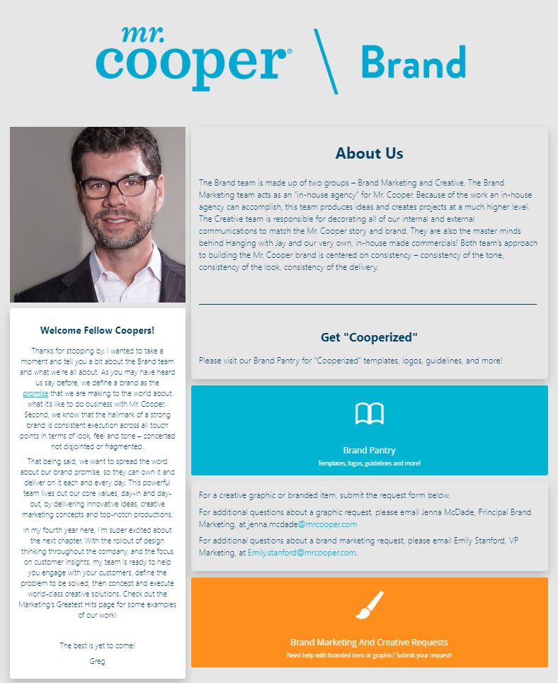
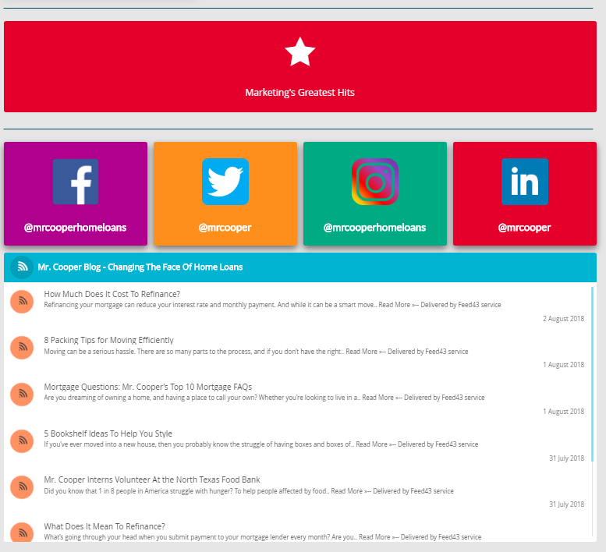
Brand
BRAND NEW

Slide 18
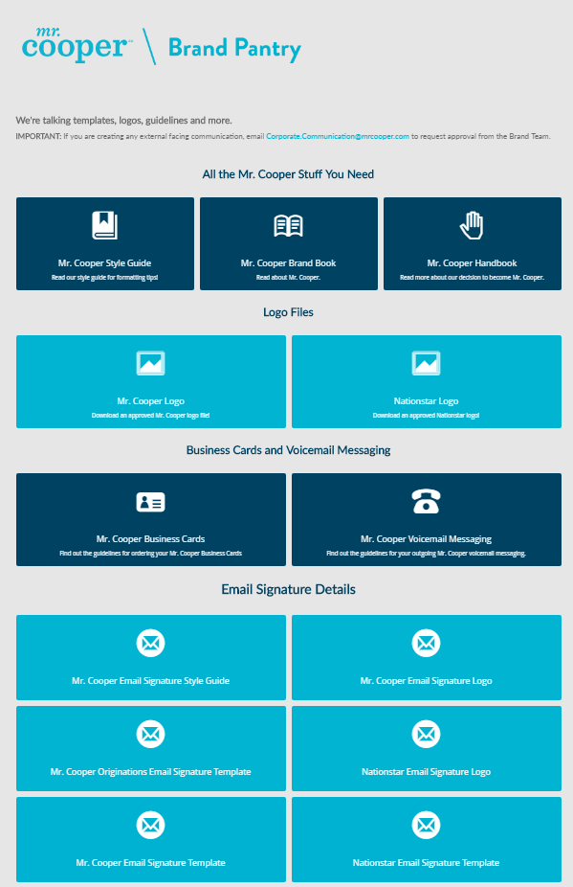
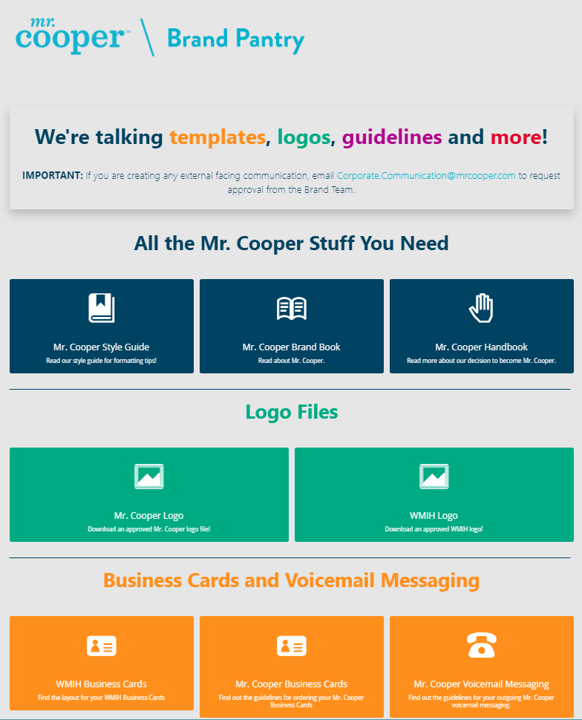
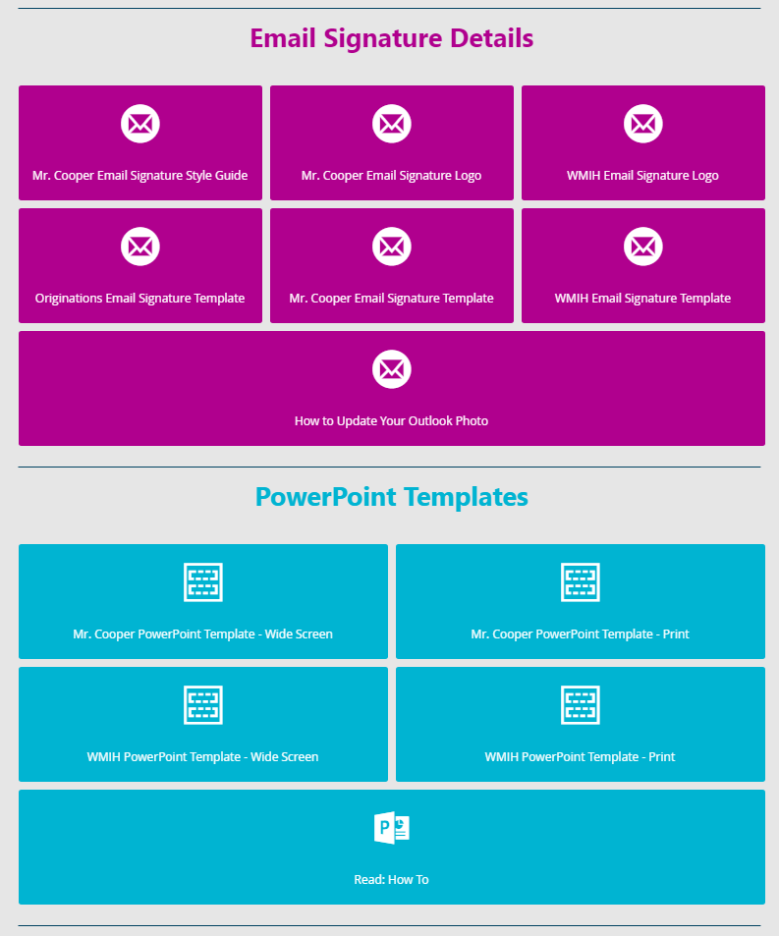
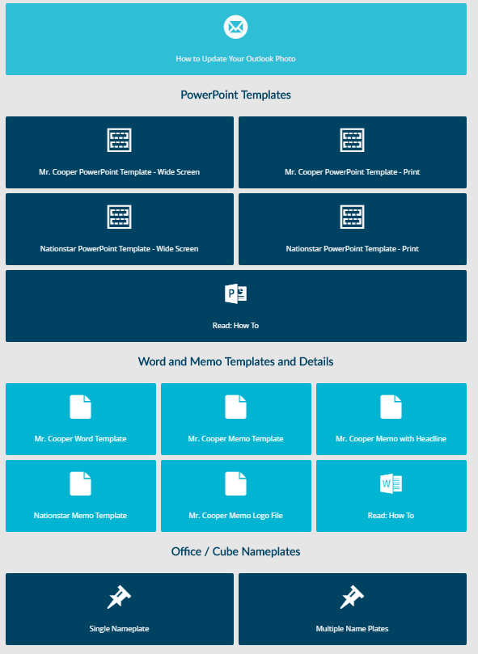
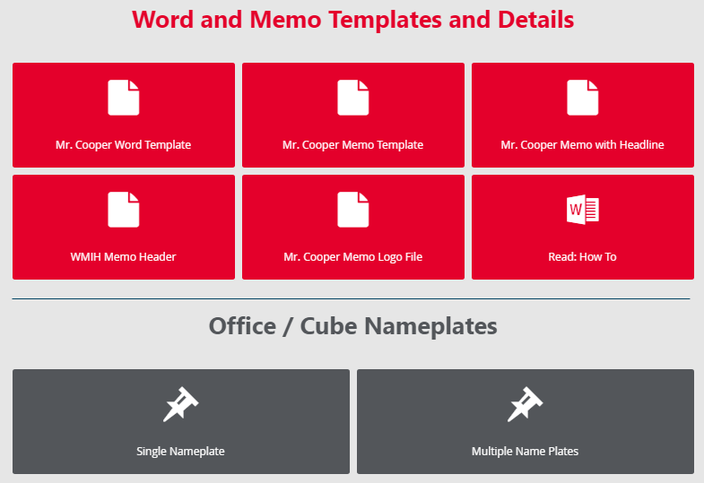
Brand Pantry
BEFORE
AFTER

Slide 19

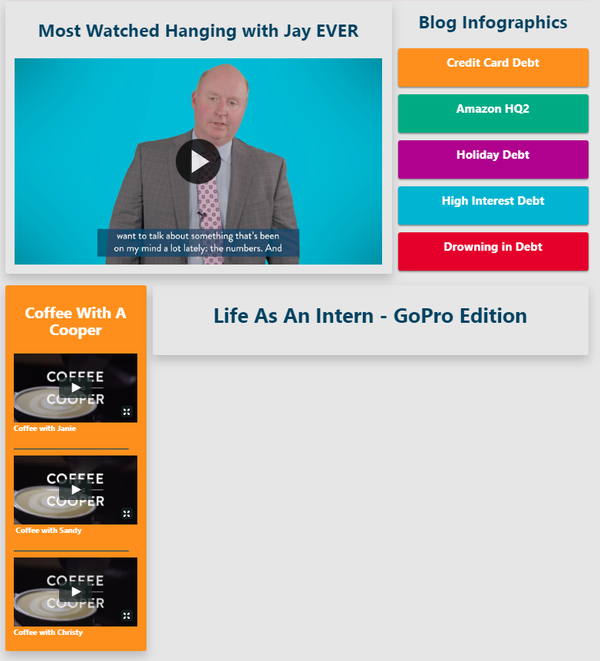
Marketing’s Greatest Hits
BRAND NEW

Slide 20
Key Takeaways

Slide 21
Key Takeaways
  Greatest Skill:
  Written Communication
  Creativity
  Biggest Challenge:
  Conducting research about our competitors
  Learning the mortgage industry
  What I’ve learned from my team members and executives:
  Say yes. Say yes. And say yes again.
  Don’t get comfortable.
  Embrace challenges.
  Proudest Moment:
  Picking out Jay Bray’s shorts for Hanging with Jay ☺

Slide 22

Thank you!

